Slide 1
The Importance of Private Sector Participation in the Public Procurement Process
Barbados - 14 June 2016

Slide 2
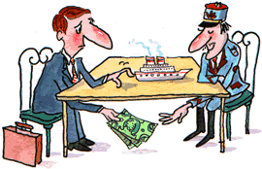

Slide 3
Public backlash against Perceived Corruption
FIFA
Guatemala 2015 – La Linea corruption case
Mexico (3 out of 3 anti-corruption law)
Brazil - vote to impeach president
Argentina – former president charged

Slide 4
Why does this corruption matter?
It’s our taxes
Inflates cost
Bad decisions
It’s unfair
Poor are hurt the most

Slide 5
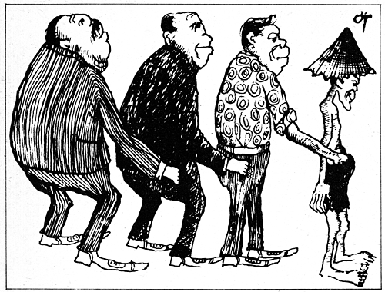

Slide 6
Ideal
Advertised publicly
Few restrictions to qualify
Clarity on what is being bid on
Transparency: publicly published results
Straightforward process to fulfil contract (duty free certificate)

Slide 7
Not Ideal
Onerous and complex pre-qualification
Excessive degrees, experience
Multiple hard to obtain certificates
Performance Bonds
Unclear conditions/Ability for bidder to define quality
Specifying a brand rather than a generic

Slide 8
SME Challenges
Administration burden if application too complex (EPA)
Cash Flow

Slide 9
Barbados Drug Service
Very transparent
Thorough but clear registration process
Formulary and tenders committees
Diverse (public and private sector) membership on both
All contract awards published and circulated to all bidders
Losing bids available on request

Slide 10
Construction
Publicly advertised
Already designed project
Some proof of competency and solvency
Tenders opened publicly at committee office
List of all bids published

Slide 11
Public Perception of honesty of various professions (Gallup poll Dec 2015)
Top – Health professionals
Near the bottom – business executives, union leaders
Bottom – political lobbyists, politicians

Slide 12
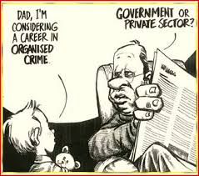

Slide 13
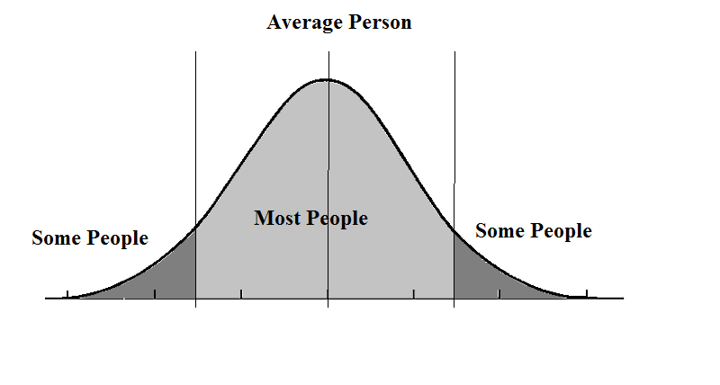

Slide 14
Wish List
Transparency
Clarity
Fairness
Straightforward process
Ability to appeal

Slide 15
Thank You!

